Slide 1

SELECTED POWERPOINT WORK
Clear, editable decks
for complex work
Executive reports, data-heavy briefings, policy training and product demonstrations.
8 decks / 408 slides / Fully editable source files
XingJie Cai · Presentation design portfolio
Notes:
Portfolio source: user-supplied PowerPoint decks. Public examples should omit confidential names, personal data and non-public client figures.

Slide 2
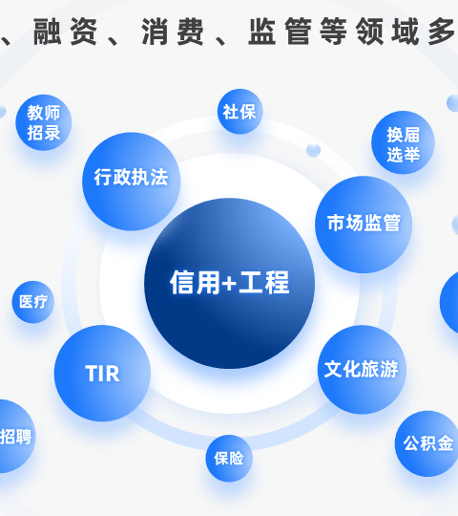
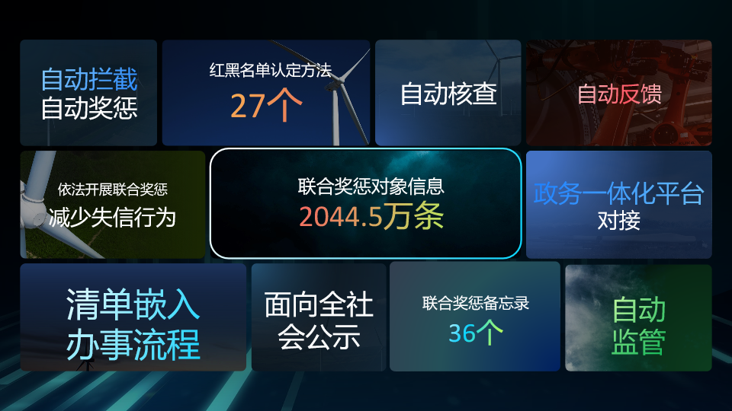
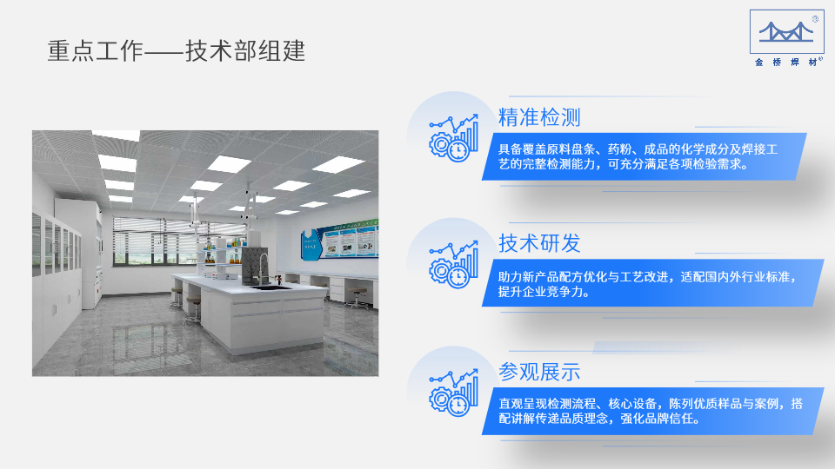
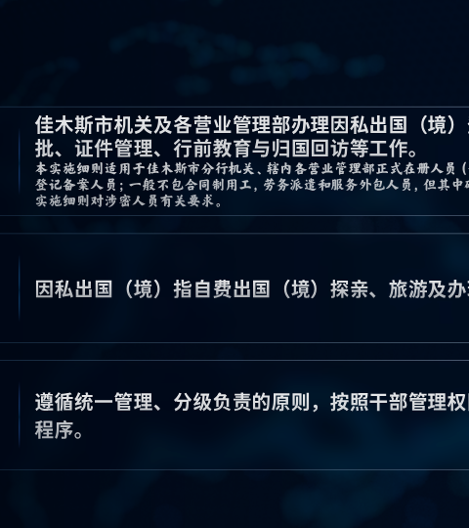
RANGE OF WORK
Four kinds of business communication
STRATEGY BRIEFING
SYSTEM DEMO
ANNUAL REVIEW
POLICY TRAINING
Public-sector programs and operating models
Product screens, workflows and measurable outcomes
Operational progress and management reporting
Rules, responsibilities and practical guidance
Selected source material has been reviewed for public presentation. Client-specific figures and identifiers should be replaced when required.
02
Notes:
Portfolio source: user-supplied PowerPoint decks. Public examples should omit confidential names, personal data and non-public client figures.

Slide 3
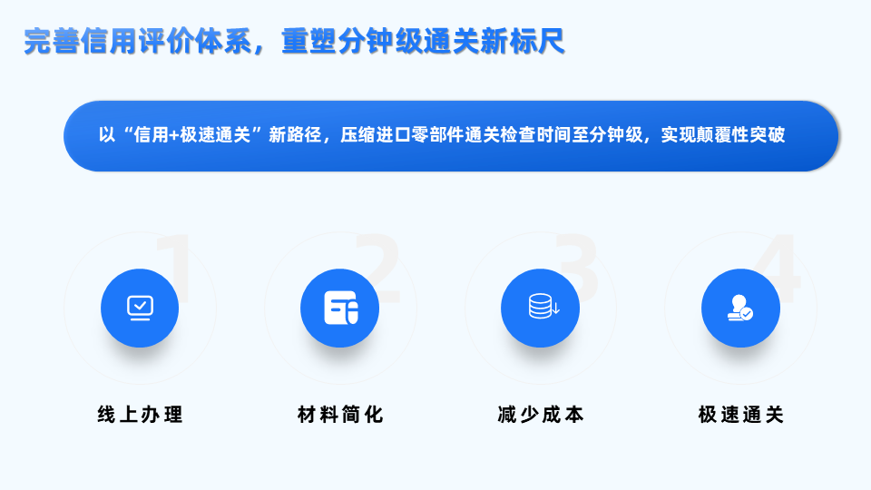
CASE 01 · STRATEGY BRIEFING
A long report turned into a sequence people can follow
Structure before decoration
Sections, evidence and transitions follow the presenter’s argument.
Data with context
Key numbers sit beside the process or decision they support.
Built for live delivery
Large type, clean contrast and visual pacing hold up in a meeting room.
A measured layout keeps the operating model visible without reducing it to a decorative diagram.
03
Notes:
Portfolio source: user-supplied PowerPoint decks. Public examples should omit confidential names, personal data and non-public client figures.

Slide 4
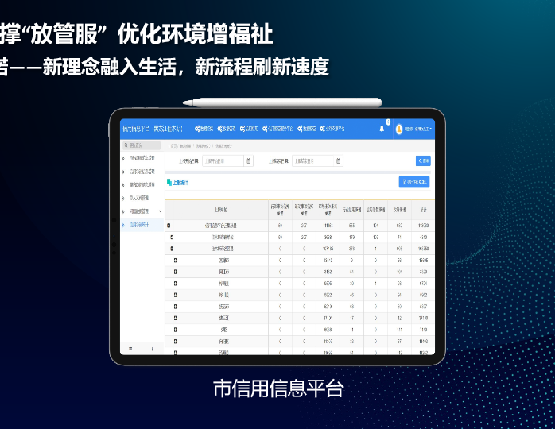
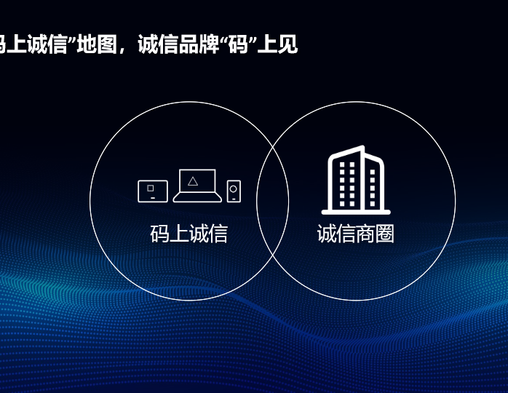
CASE 02 · PRODUCT DEMONSTRATION
Software stories need evidence, not decorative mockups
The deck combines real interfaces, process diagrams and operating metrics so buyers can see how the system works.
Screens remain readable. Visual emphasis follows the demonstration path.
04
Notes:
Portfolio source: user-supplied PowerPoint decks. Public examples should omit confidential names, personal data and non-public client figures.

Slide 5
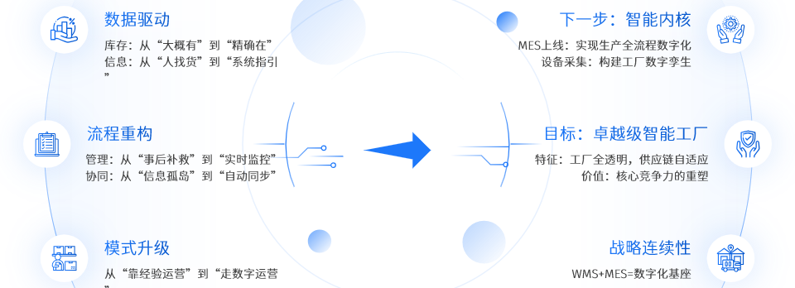
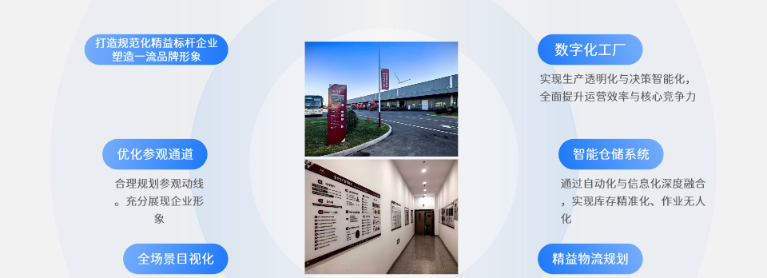
CASE 03 · ANNUAL REVIEW
Management reporting with a restrained visual system
Consistent margins, controlled color and clear reading order keep dense internal reporting usable.
05
Notes:
Portfolio source: user-supplied PowerPoint decks. Public examples should omit confidential names, personal data and non-public client figures.

Slide 6
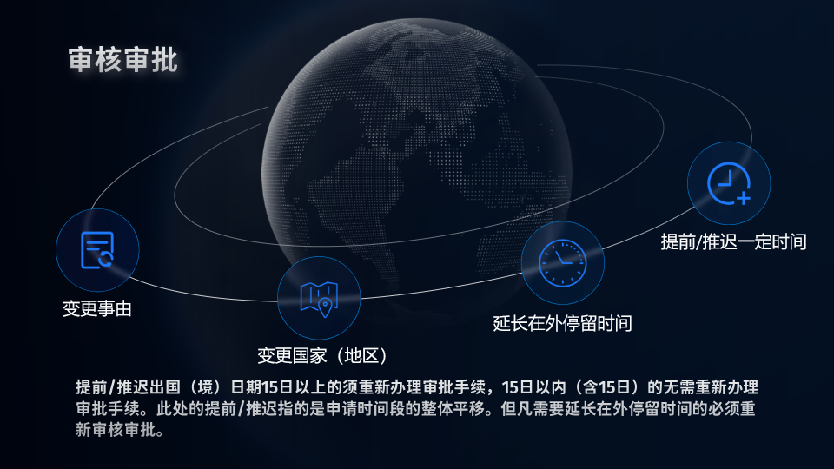
CASE 04 · POLICY TRAINING
Rules become easier to use when the visual hierarchy matches the decision
The source deck organizes eligibility, approvals, timing and recordkeeping into distinct steps. The result supports training and later reference.
Formal tone · Chinese-language layout · 35-slide system
06
Notes:
Portfolio source: user-supplied PowerPoint decks. Public examples should omit confidential names, personal data and non-public client figures.

Slide 7
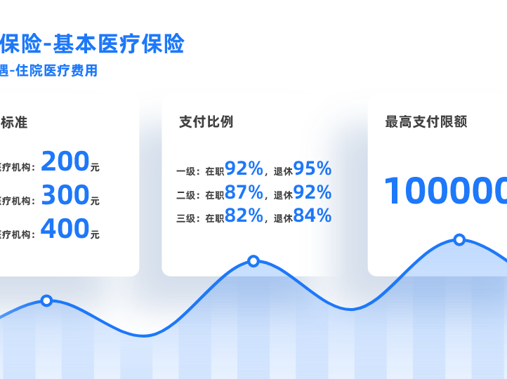
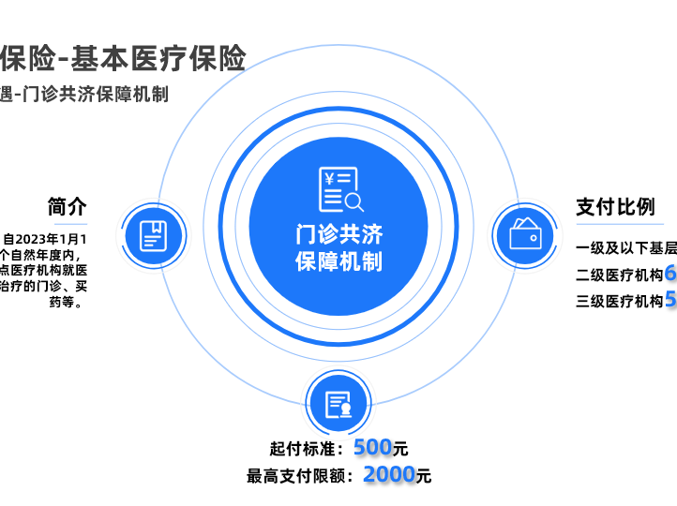
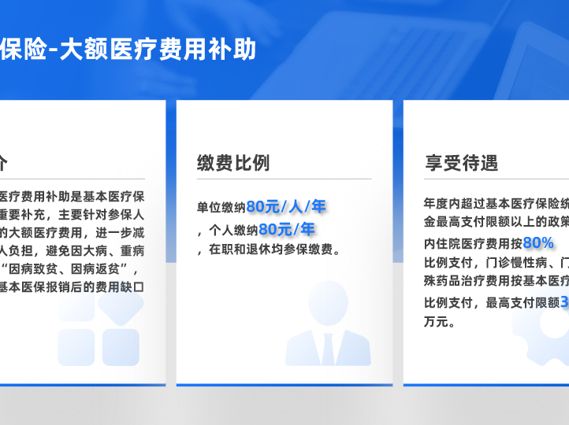
CASE 05 · INFORMATION DESIGN
Dense source material, edited into usable pages
Comparison
Mechanism
Summary
Show differences at a glance.
Explain how a rule works.
Keep reference material readable.
The design changes with the information. It does not force every slide into the same template.
07
Notes:
Portfolio source: user-supplied PowerPoint decks. Public examples should omit confidential names, personal data and non-public client figures.

Slide 8
WORKING METHOD
A professional deck is built through decisions
01
Review
Purpose, audience, source files and deadline
02
Structure
Narrative order, slide purpose and evidence
03
Design
Layouts, charts, diagrams and image treatment
04
Quality check
Alignment, readability, consistency and editability
Calls are optional. Briefs, questions, review notes and approvals can stay in writing.
08
Notes:
Portfolio source: user-supplied PowerPoint decks. Public examples should omit confidential names, personal data and non-public client figures.

Slide 9
PROJECT PACKAGES
Fixed-scope presentation work
$300
$650
$1,100
Focused redesign
Business deck
Complex report deck
Up to 10 slides
3 business days
1 revision
Up to 20 slides
5 business days
2 revisions
Up to 35 slides
7–10 business days
2 revisions
All packages include an editable PPTX and a presentation-ready PDF. Pricing assumes supplied content and one visual direction.
09
Notes:
Portfolio source: user-supplied PowerPoint decks. Public examples should omit confidential names, personal data and non-public client figures.

Slide 10
AVAILABLE FOR NEW PROJECTS
Presentation design for work that has to stand up to scrutiny
Best fit
Delivery
Communication
Executive briefings
Formal reports
Training decks
Product demonstrations
Editable PowerPoint
PDF export
Written review notes
Clear handoff
Platform messages
Written briefs
Marked-up feedback
No call required
Portfolio contact: message through Upwork or Contra
10
Notes:
Portfolio source: user-supplied PowerPoint decks. Public examples should omit confidential names, personal data and non-public client figures.

